Slide 1

Stability and Chaos in Networks of Spiking Neurons
Monteforte & Wolf (2012).
Dynamic Flux Tubes Reservoirs of Stability in Neuronal Circuits.
Physical Review X
Thorben Haag, Roya Eskandani, Ulas Ayyilmaz
Introduction - Research Question - Model - Results - Conclusion

Slide 2
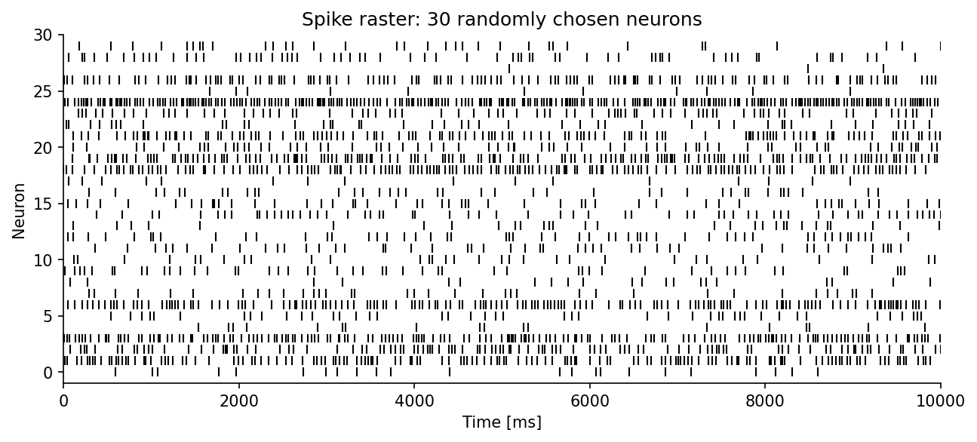
Central Research Question
Cortical networks: irregular & asynchronous activity
Single spike perturbations can decorrelate the detailed spike pattern (‘microstate’) [London et al. 2010]
Fig. 1
How do perturbations affect the dynamics?
Introduction - Research Question - Model - Results - Conclusion
Notes:
Experimental: “decorrelate network state” “change the microstate of the network”

Slide 3
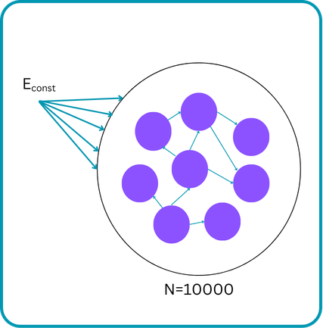
The Model Network
Recurrent inhibitory LIF neurons
Sparse connections: 10% connectivity
Constant external excitatory drive delivered to all N neurons
Balanced state dynamics
Fig. 2
Introduction - Research Question - Model - Results - Conclusion
Notes:
Diagram: network (circles) Graph/picture, Equations

Slide 4
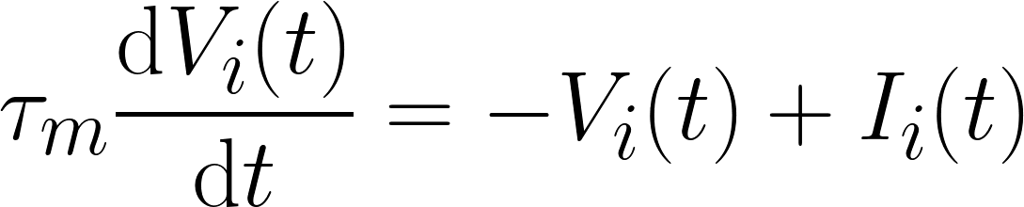
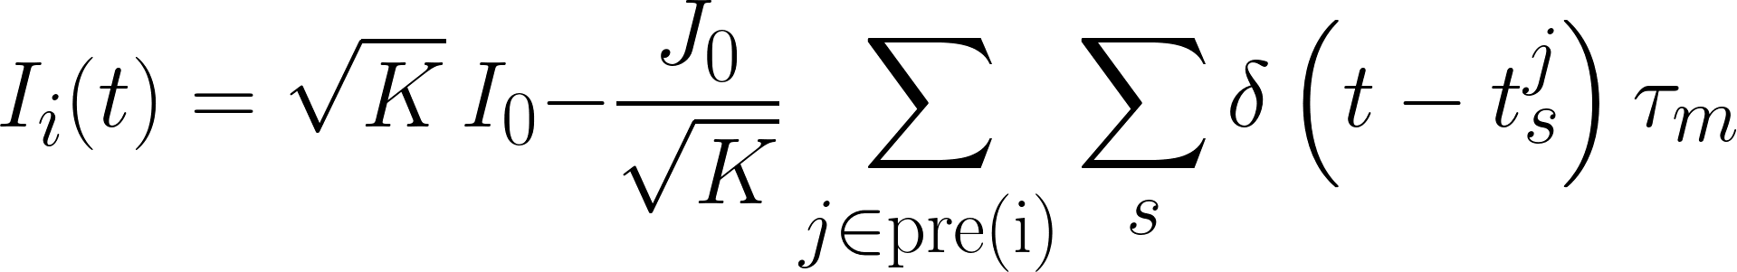
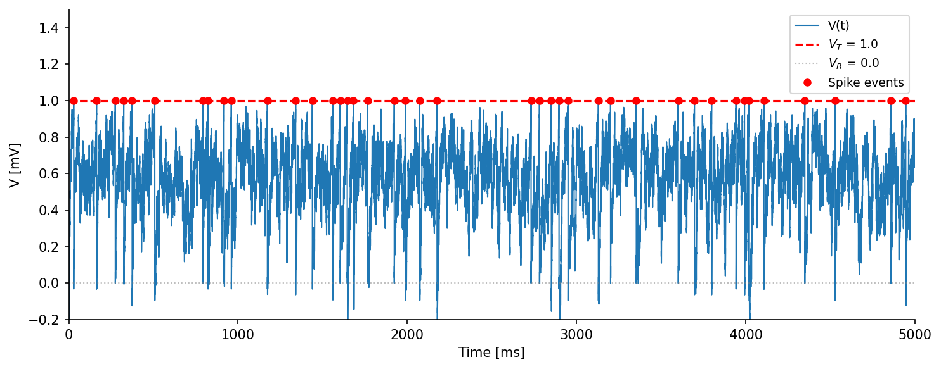
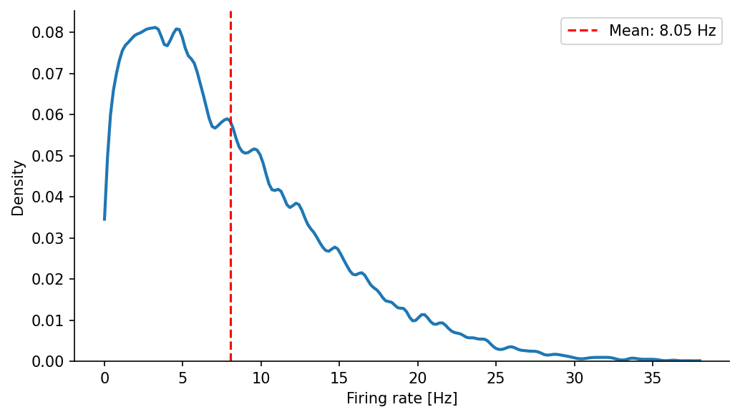
Network Dynamics
LIF Equation:
Synaptic Input:
Fig. 1
Firing Rate
Fig. 3
Fig. 4
Introduction - Research Question - Model - Results - Conclusion
Notes:
So How does this all fit together? We are investigating affects of perturbations on dynamical systems. And we are working with recurrent inhibitory neural networks to investigate this phenomena.

Slide 5
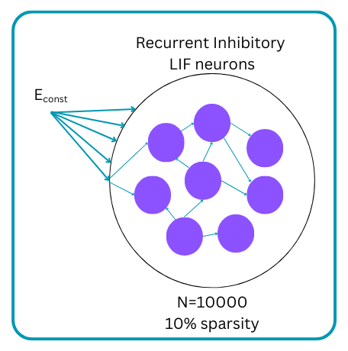
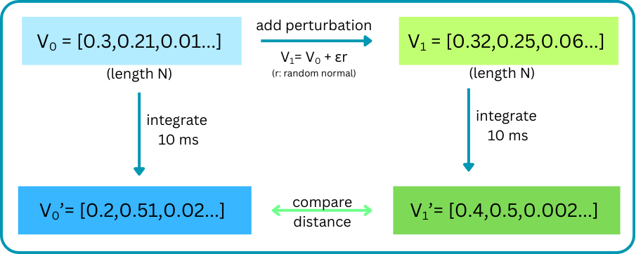
Network Perturbation
Fig. 2
Fig. 5
Introduction - Research Question - Model - Results - Conclusion
Notes:
So, as Roya mentioned, we have a network of 10k recurrently connected inhibitory neurons. This operates operates in a dynamic dictated by the interaction of the constant exc input and the current based instantaneous inhibitory synapses.
So, when we initialize voltages of all neurons in a uniform distribution between 0 and 1, 0 being the reset potential, and 1 being the threshold for action potential, and when we let the network free run, we observe the voltages of each neuron evolving. For instance, in fig 5, we see an example schematic of an initial voltage vector light blue) of length 10k, and a final voltage vector (dark blue) which stores the voltage values of all neurons after they’ve been integrated 10 milliseconds. (our brian code ran in 0.1 ms intervals.)
So, now, okay, we have initial and final voltage values as well as all voltages in intermediate time steps. Our research question is the effects of perturbations on this voltage evolution. So we introduce a perturbation (the arrow from light blue to light green vector) that is a random normal vector r multiplied by a scalar epsilon value(r is random normal with mean 0). V1 is our perturbed vector of voltages. Then we free run it and record all the voltages including the final, and we compare the voltage vectors per timestep.

Slide 6
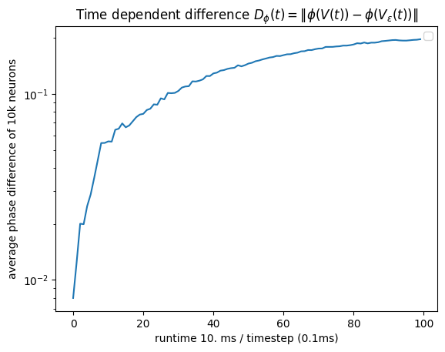
ε = 1
Divergence of Trajectories
Fig. 5
Fig. 6
Diverging trajectories!
Introduction - Research Question - Model - Results - Conclusion
Notes:
Fig 6 gives us a Voltage difference vs time curve of the original and perturbed network voltages.
Difference calculated as norm of difference of voltage vectors at each time step
Here, we observe that the difference at time 0 is quite small at 0.01, but it evolves and approaches 1 as both networks run free.
So, here we see a “decorrelation” between the dynamics of the original network and the perturbed network we got from the original network.
We characterize this behavior with the phrase “diverging trajectories in the voltage space of the network”.
We can think of voltage space as an N dimensional space where each dimension represents voltage of a neuron. With each time step, the network’s position in this N dimensional space changes, because voltage of each neuron likely changes. So our network follows a trajectory in this space.
And we want to characterize this behavior of networks taking on different trajectories.

Slide 7
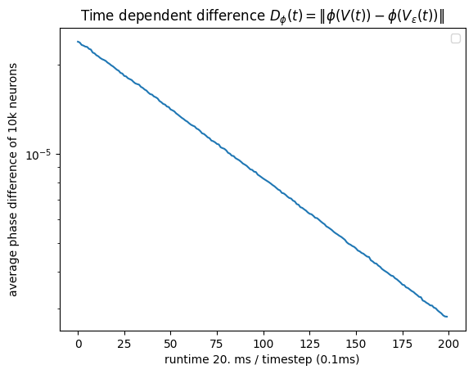

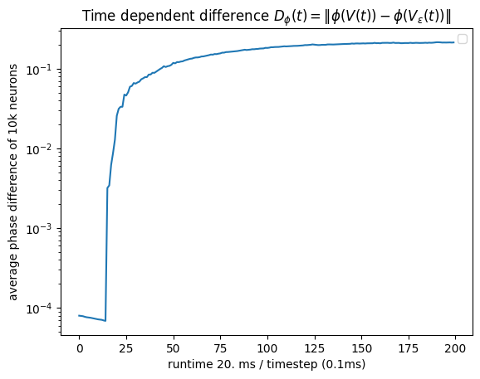
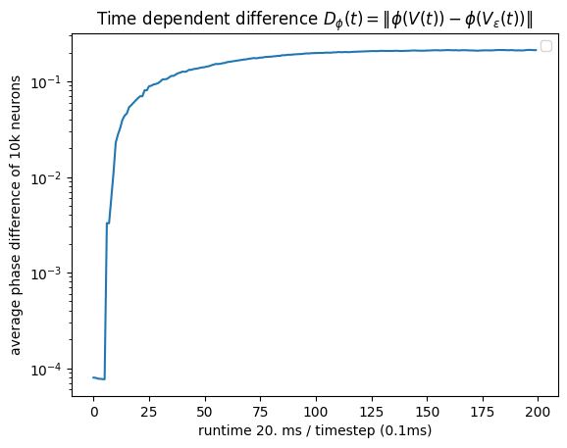
ε = 0.003
Varying Perturbation
ε = 0.001
ε = 0.01
Fig. 7
Fig. 10
Fig. 8 & 9
Convergence
Convergence and Divergence
Divergence
Introduction - Research Question - Model - Results - Conclusion
Notes:
We try different epsilon values. We hypothesize that tiny perturbations will not cause decorrelation of the original network’s trajectory. We see that when epsilon is 0.001, the distance between the original and the perturbed networks decreases to close to 0. This indicates that the original and the perturbed network converge in the same trajectory in voltage space.
On the other hand when the epsilon is 0.01, the right figure, we observe that the difference grows quickly. So the original network and the perturbed network finds different trajectories. And by trying epsilons, we also find epsilon values for which the state trajectories sometimes diverge and sometimes converge.

Slide 8
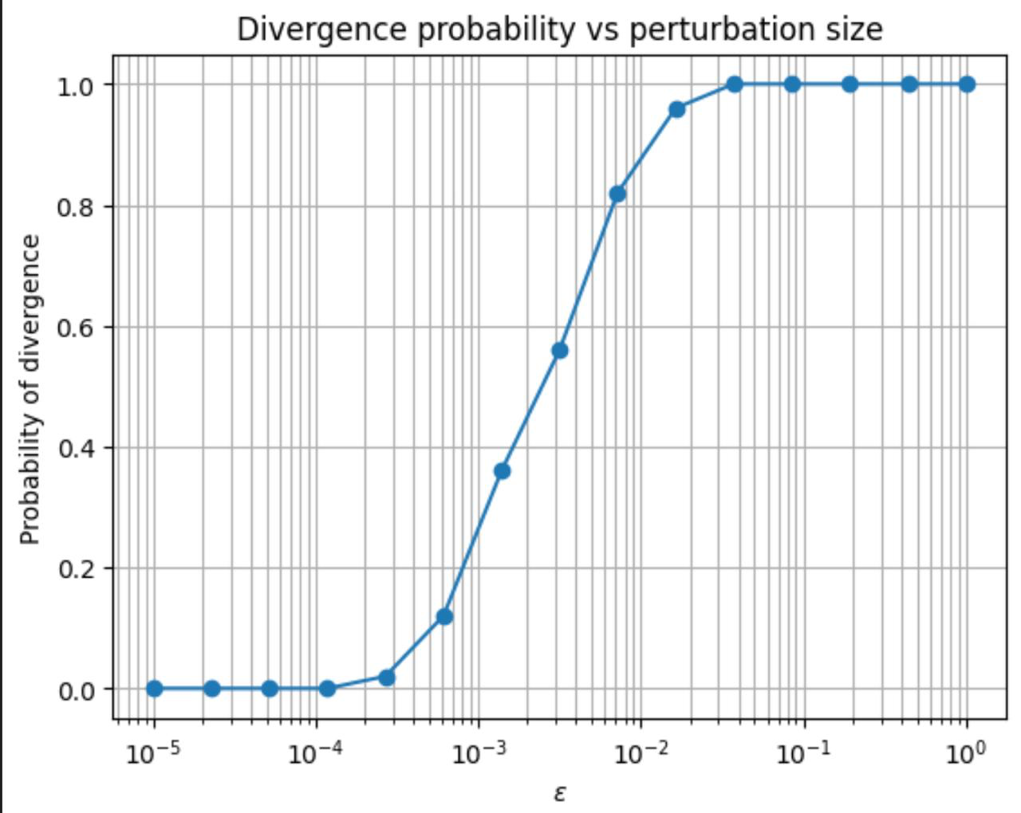
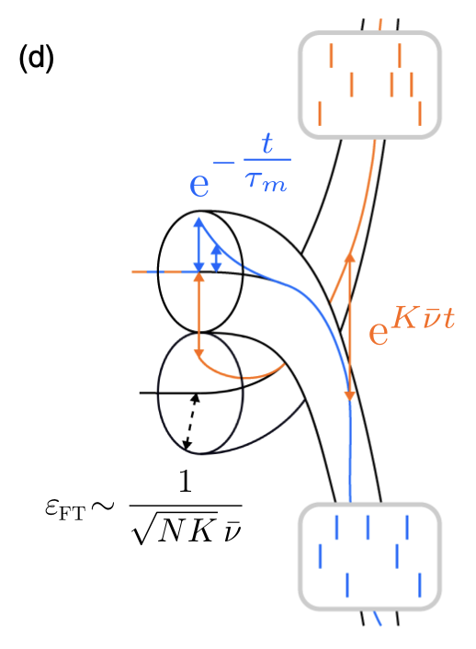
Sensitivity to finite perturbations
Fig. 11
Monteforte & Wolf (2012)
Introduction - Research Question - Model - Results - Conclusion
Notes:
Plot:

Slide 9
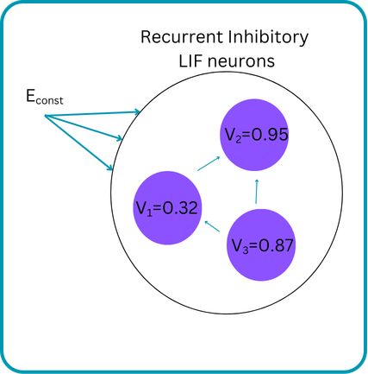
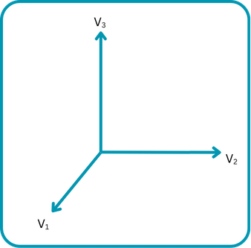
Voltage Space
Fig. 12
Fig. 13
Introduction - Research Question - Model - Results - Conclusion

Slide 10
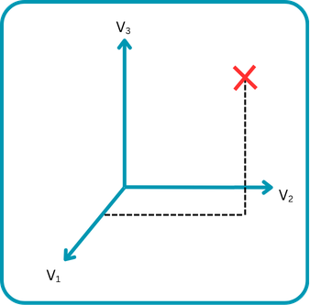
Voltage Space
Fig. 12
Fig. 14
Introduction - Research Question - Model - Results - Conclusion

Slide 11
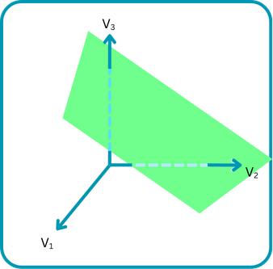
Voltage Space
Fig. 12
Fig. 15
Introduction - Research Question - Model - Results - Conclusion

Slide 12
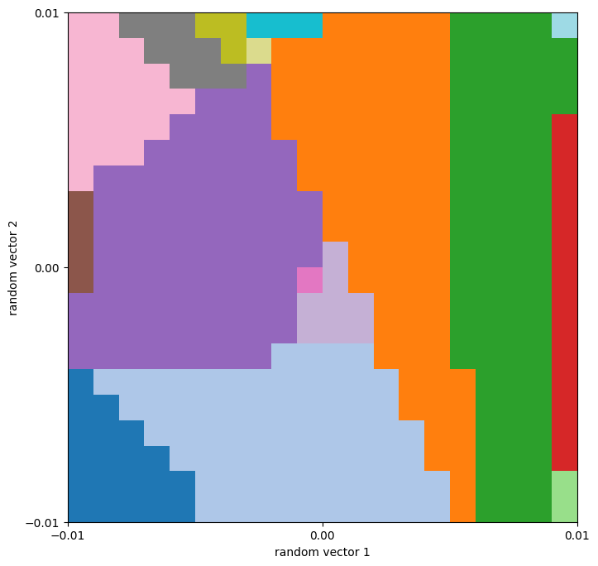
Visualization of the phase-space structure
Fig. 16
Introduction - Research Question - Model - Results - Conclusion
Notes:
Plot:

Slide 13
Conclusion
Special configuration of the dynamical system allows both convergence and divergence after perturbation.
Introduction - Research Question - Model - Results - Conclusion

Slide 14
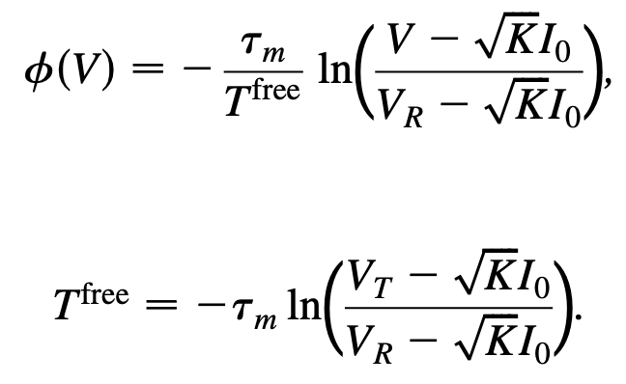
Additional Following
Phase space

Slide 15
Additional Following
Flux tube

